Slide 1

Fragile Mind
The four stages of a crisis (from my own experiences)

Slide 2

The Silent Scream
I am screaming inside, but am unable to communicate how I feel, my despair going unnoticed by all around me.
This is the first stage of an impending crisis and one of the earliest points it can be stopped.
By working closely with care coordinators, carers, psychologists and the service user, these early signs can be detected and actions taken to stop the crisis in its tracks.

Slide 3

Ignition point
My screams have gone unheard, I start to break up inside, my mind shattering like glass.
This is the second stage of a crisis where I visibly begin to fall apart as I struggle to cope with daily life.
If my crisis hasn’t been identified by this stage, it is definitely time for action, before it fully engulfs me.
Intervention at this point can stop my crisis developing and the correct treatment can put me on track to a speedy recovery.

Slide 4

Inferno
All the warning signs have either gone unnoticed, or have not been acted on.
This is the point at which I would usually contact the crisis team, with my rational mind consumed by my emotions.
I am past the point at which I can communicate coherently.
It is up to my wife to try and get me the support I need.
This was the point of failure when I last contacted the crisis team.
Caring support and speedy action is what is most needed at this time, to put out the fire before its too late!

Slide 5
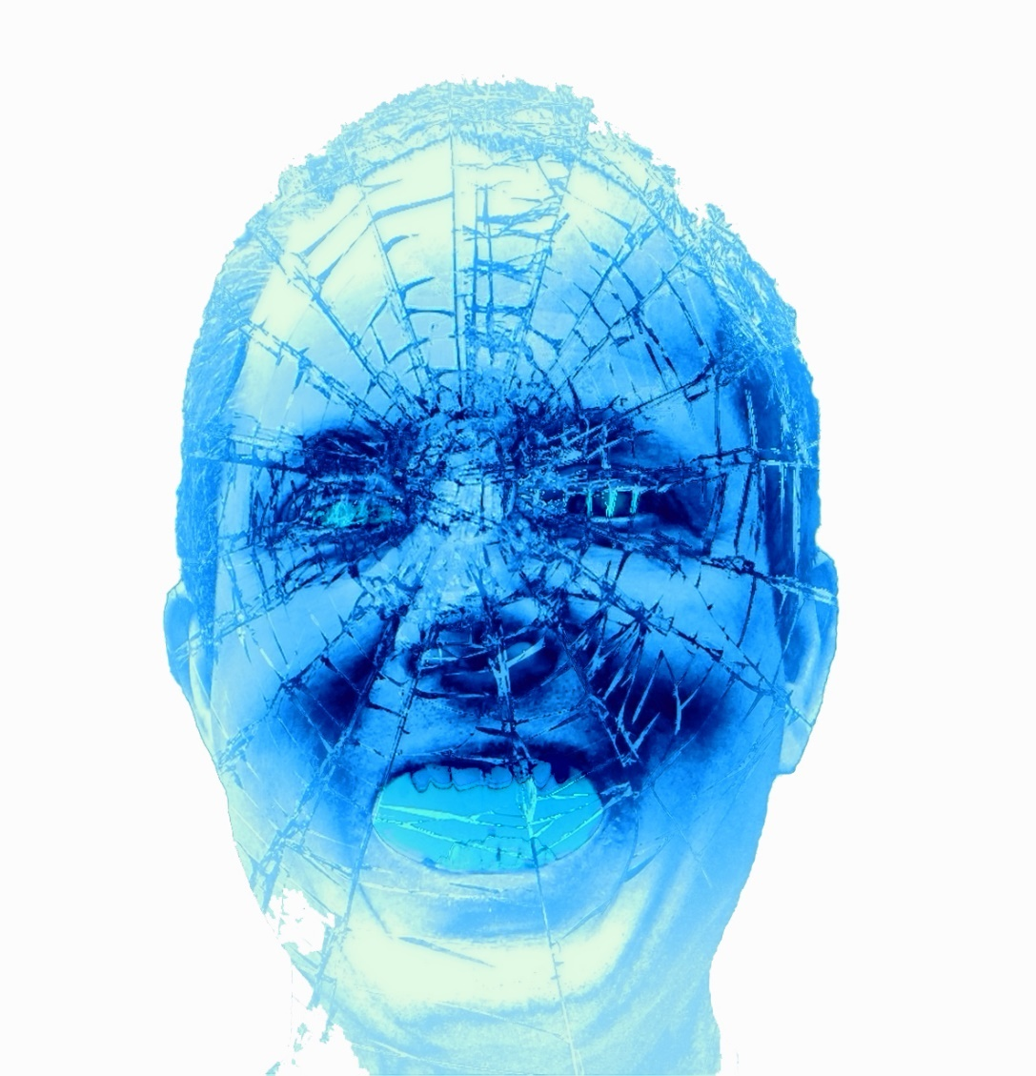
Broken and Blue
All opportunities to stop the crisis have failed and all that is left is an empty blue shell.
At this stage I will most likely have been admitted to hospital on the acute ward.
This is my last refuge from the world and the demons inside my mind.
I am now beyond caring, my life in tatters, time being my only healer now
Notes:
5

